Slide 1


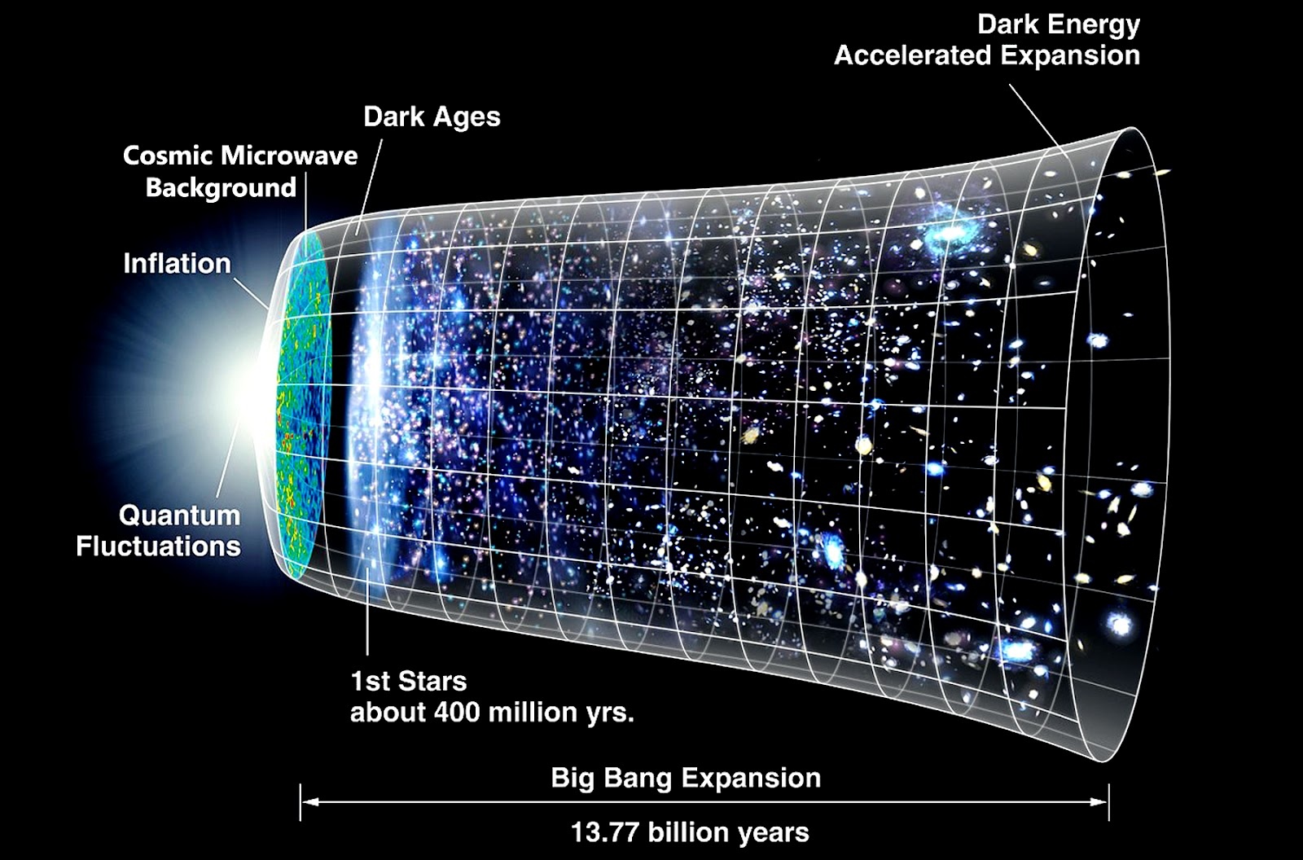
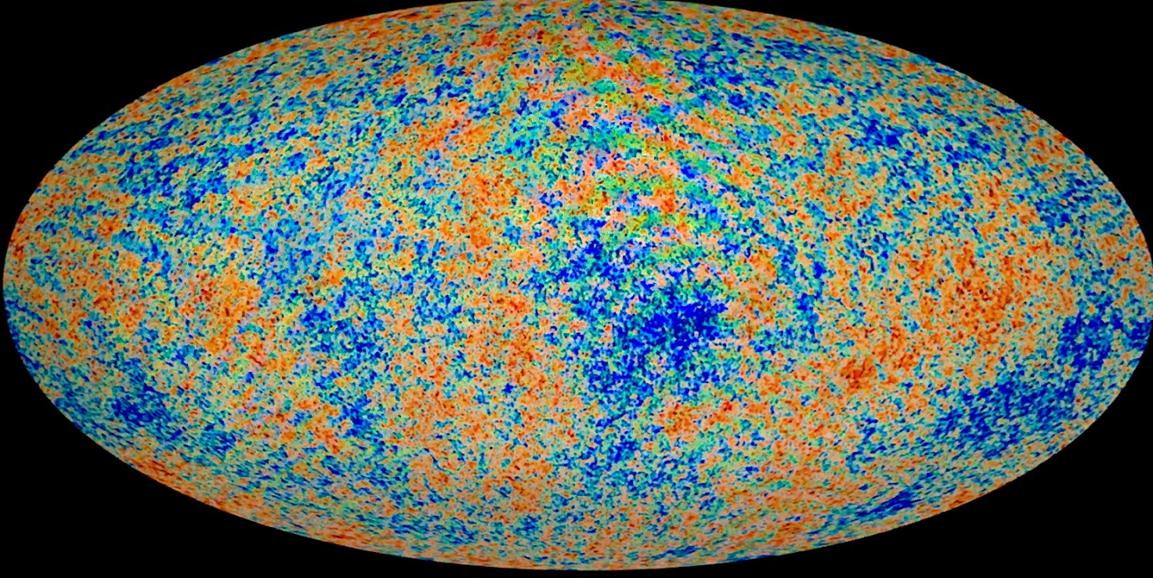
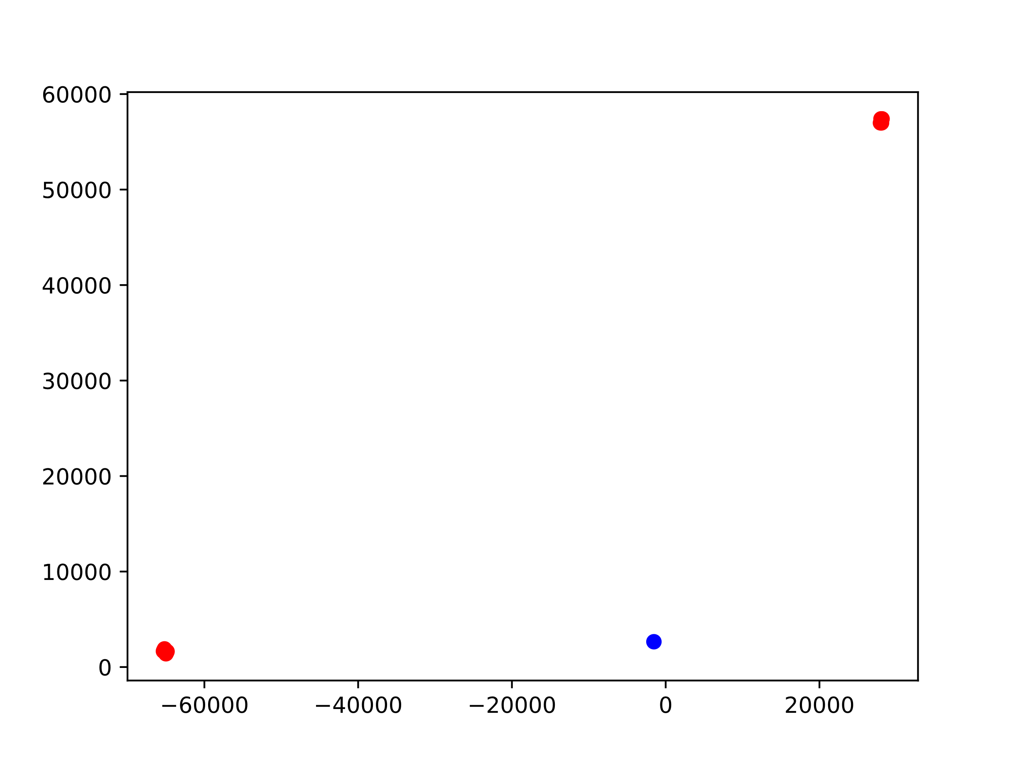
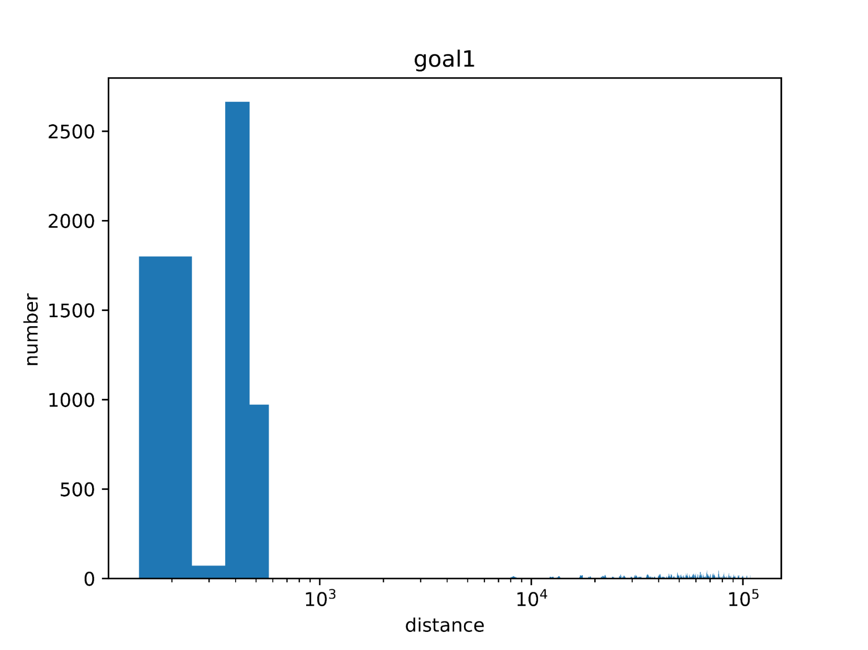
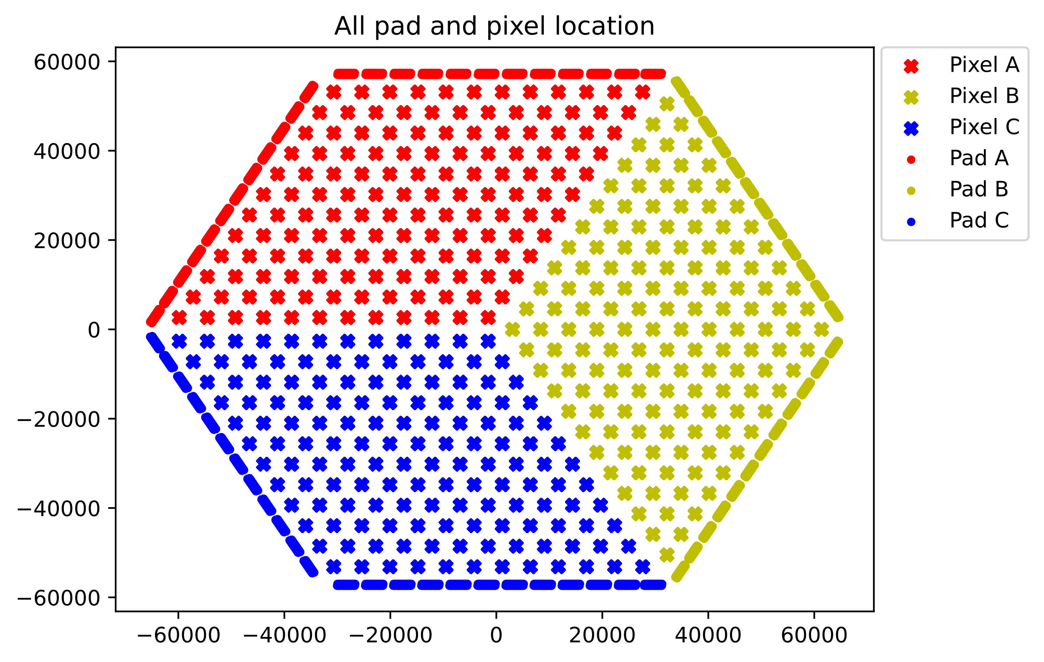
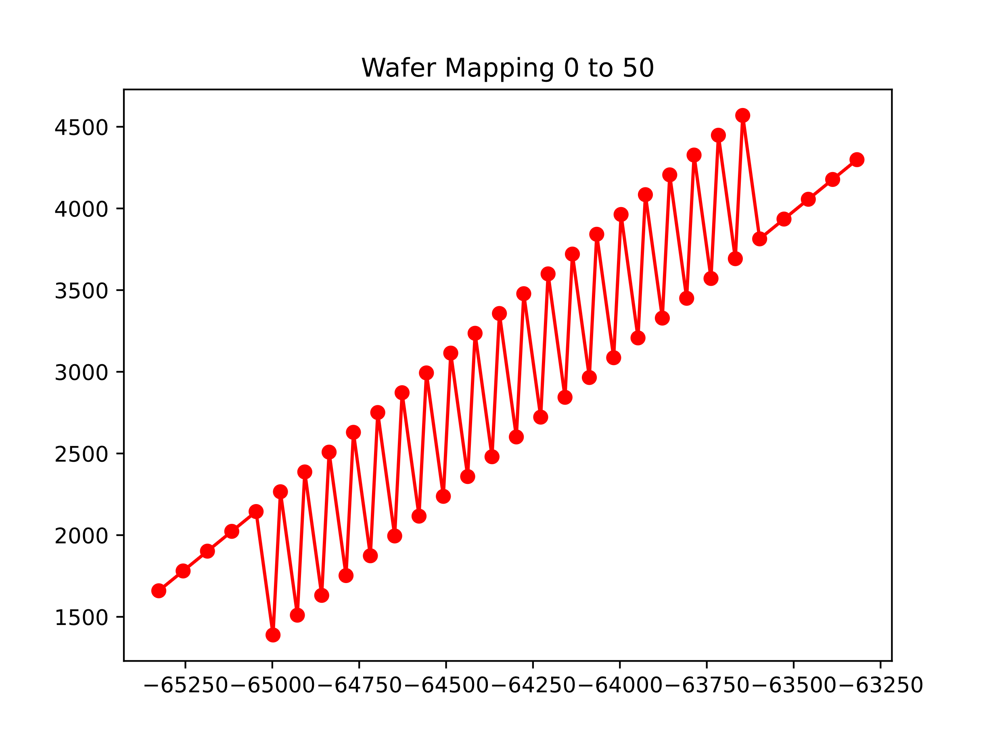
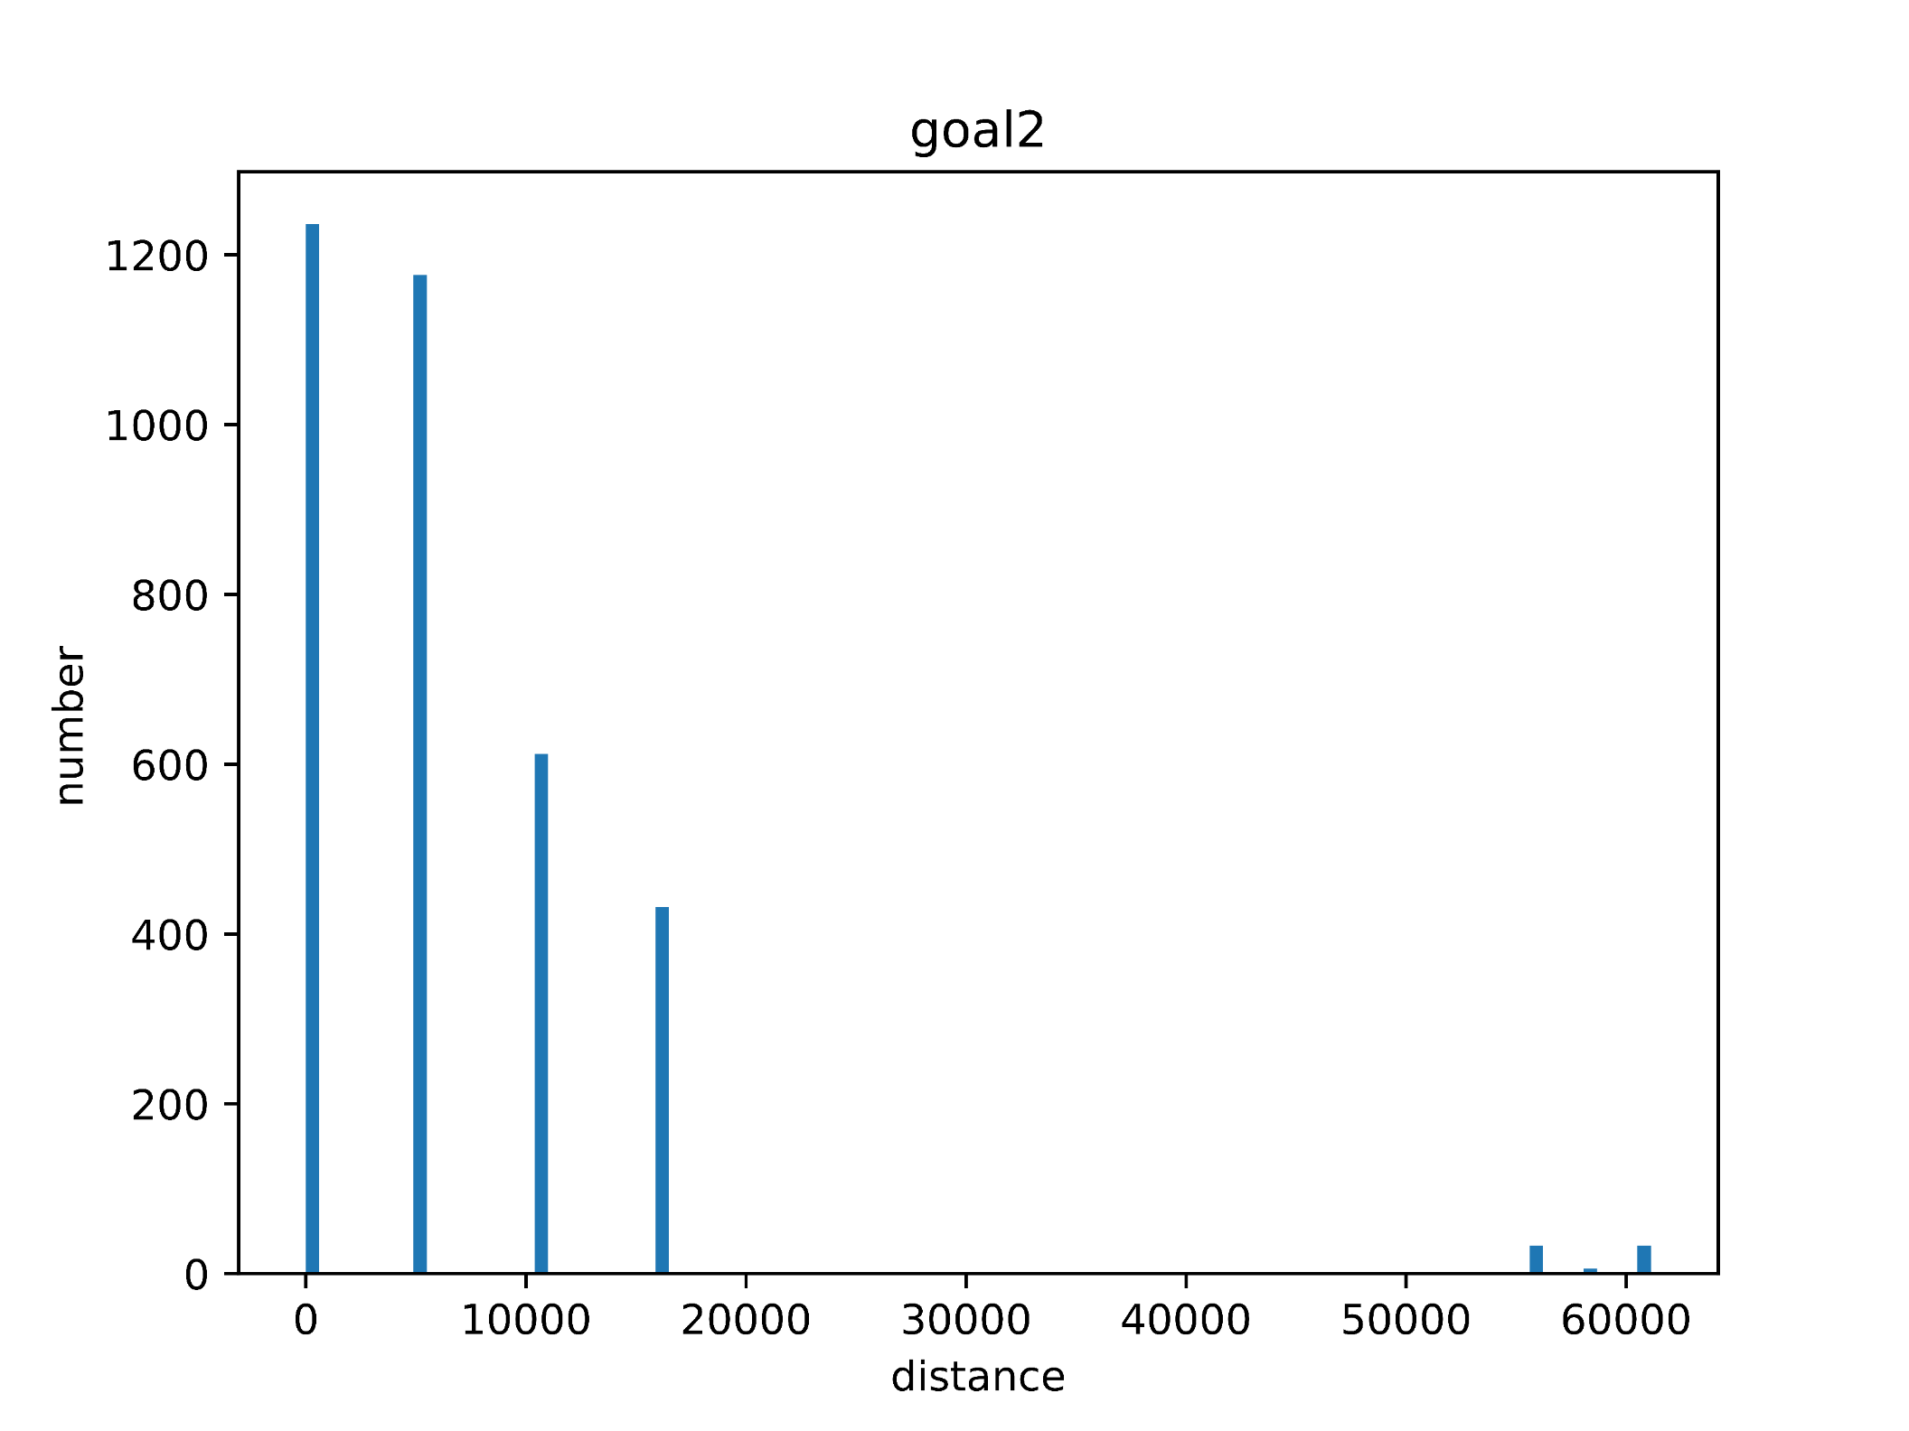
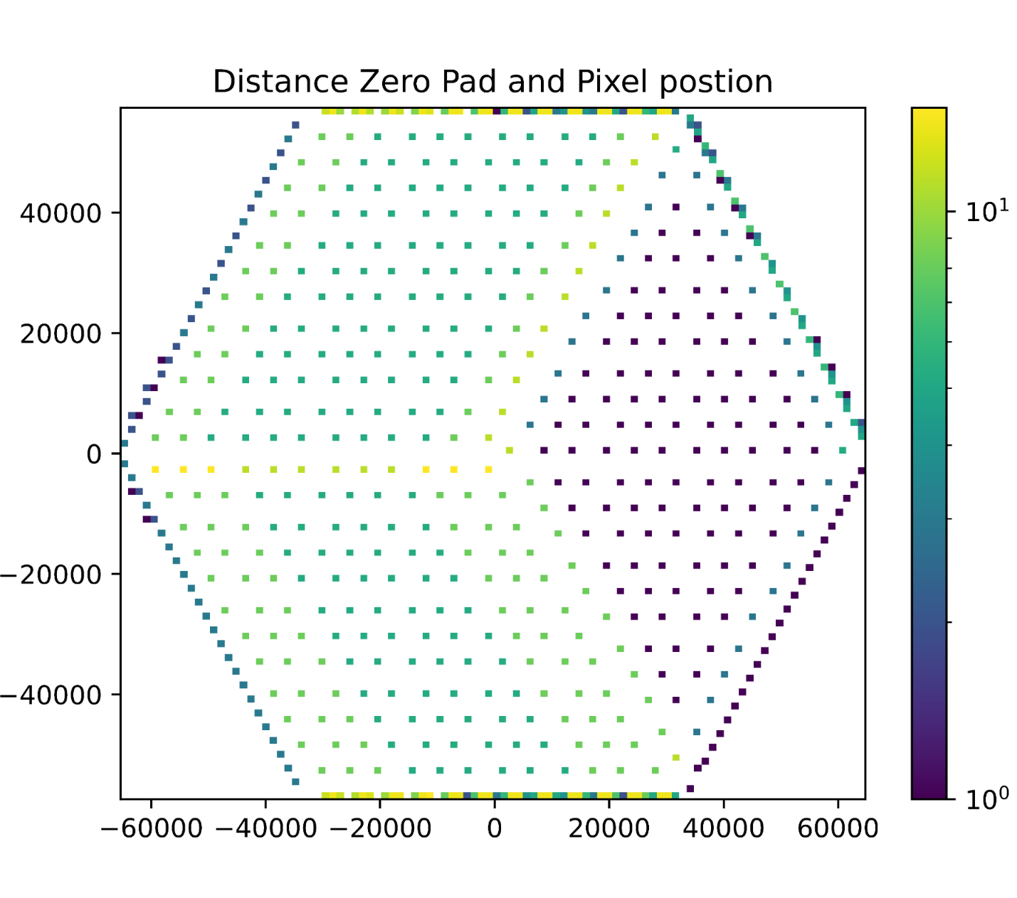
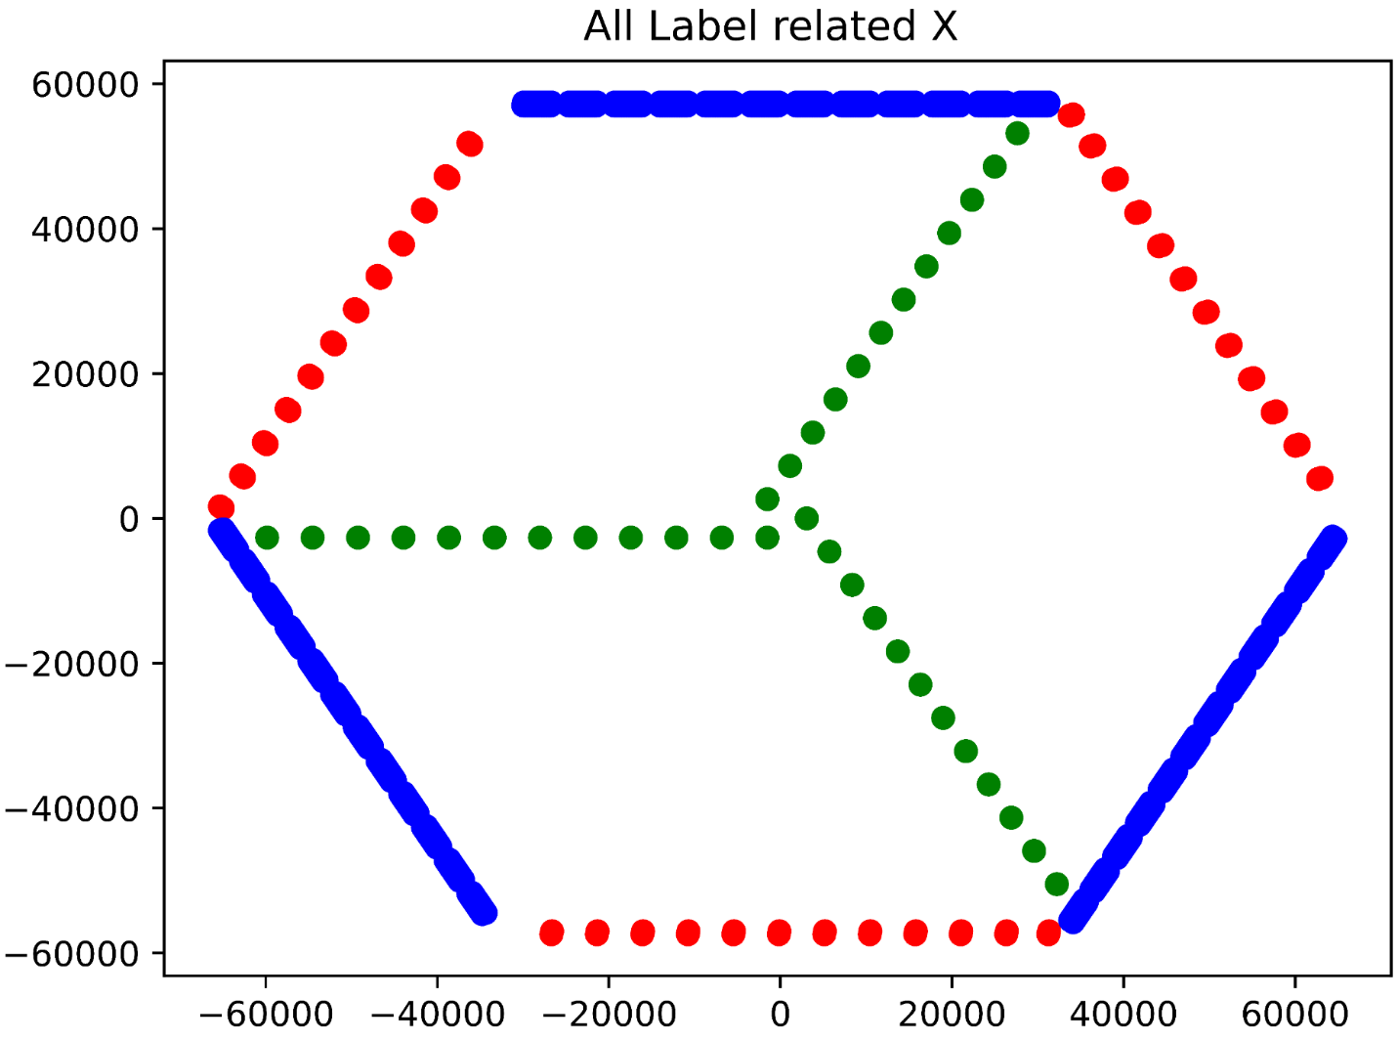
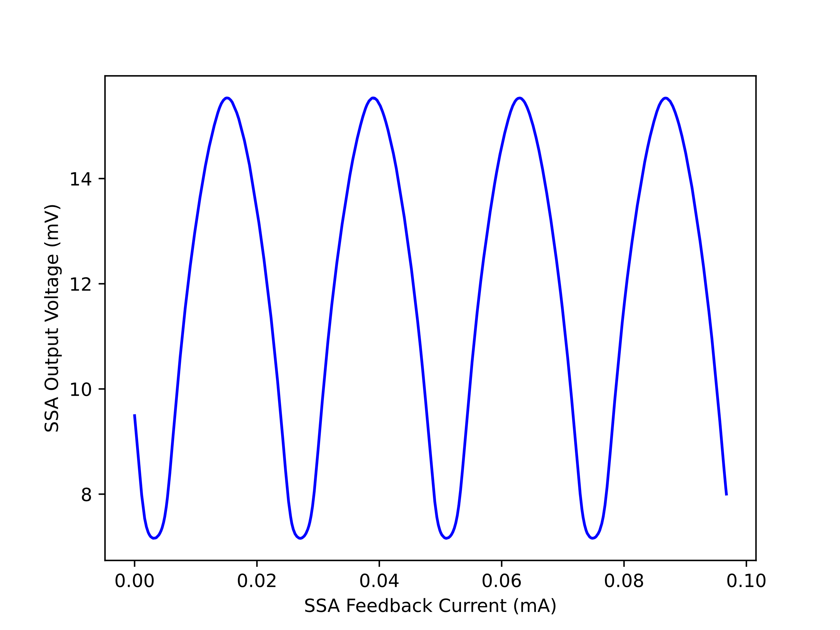
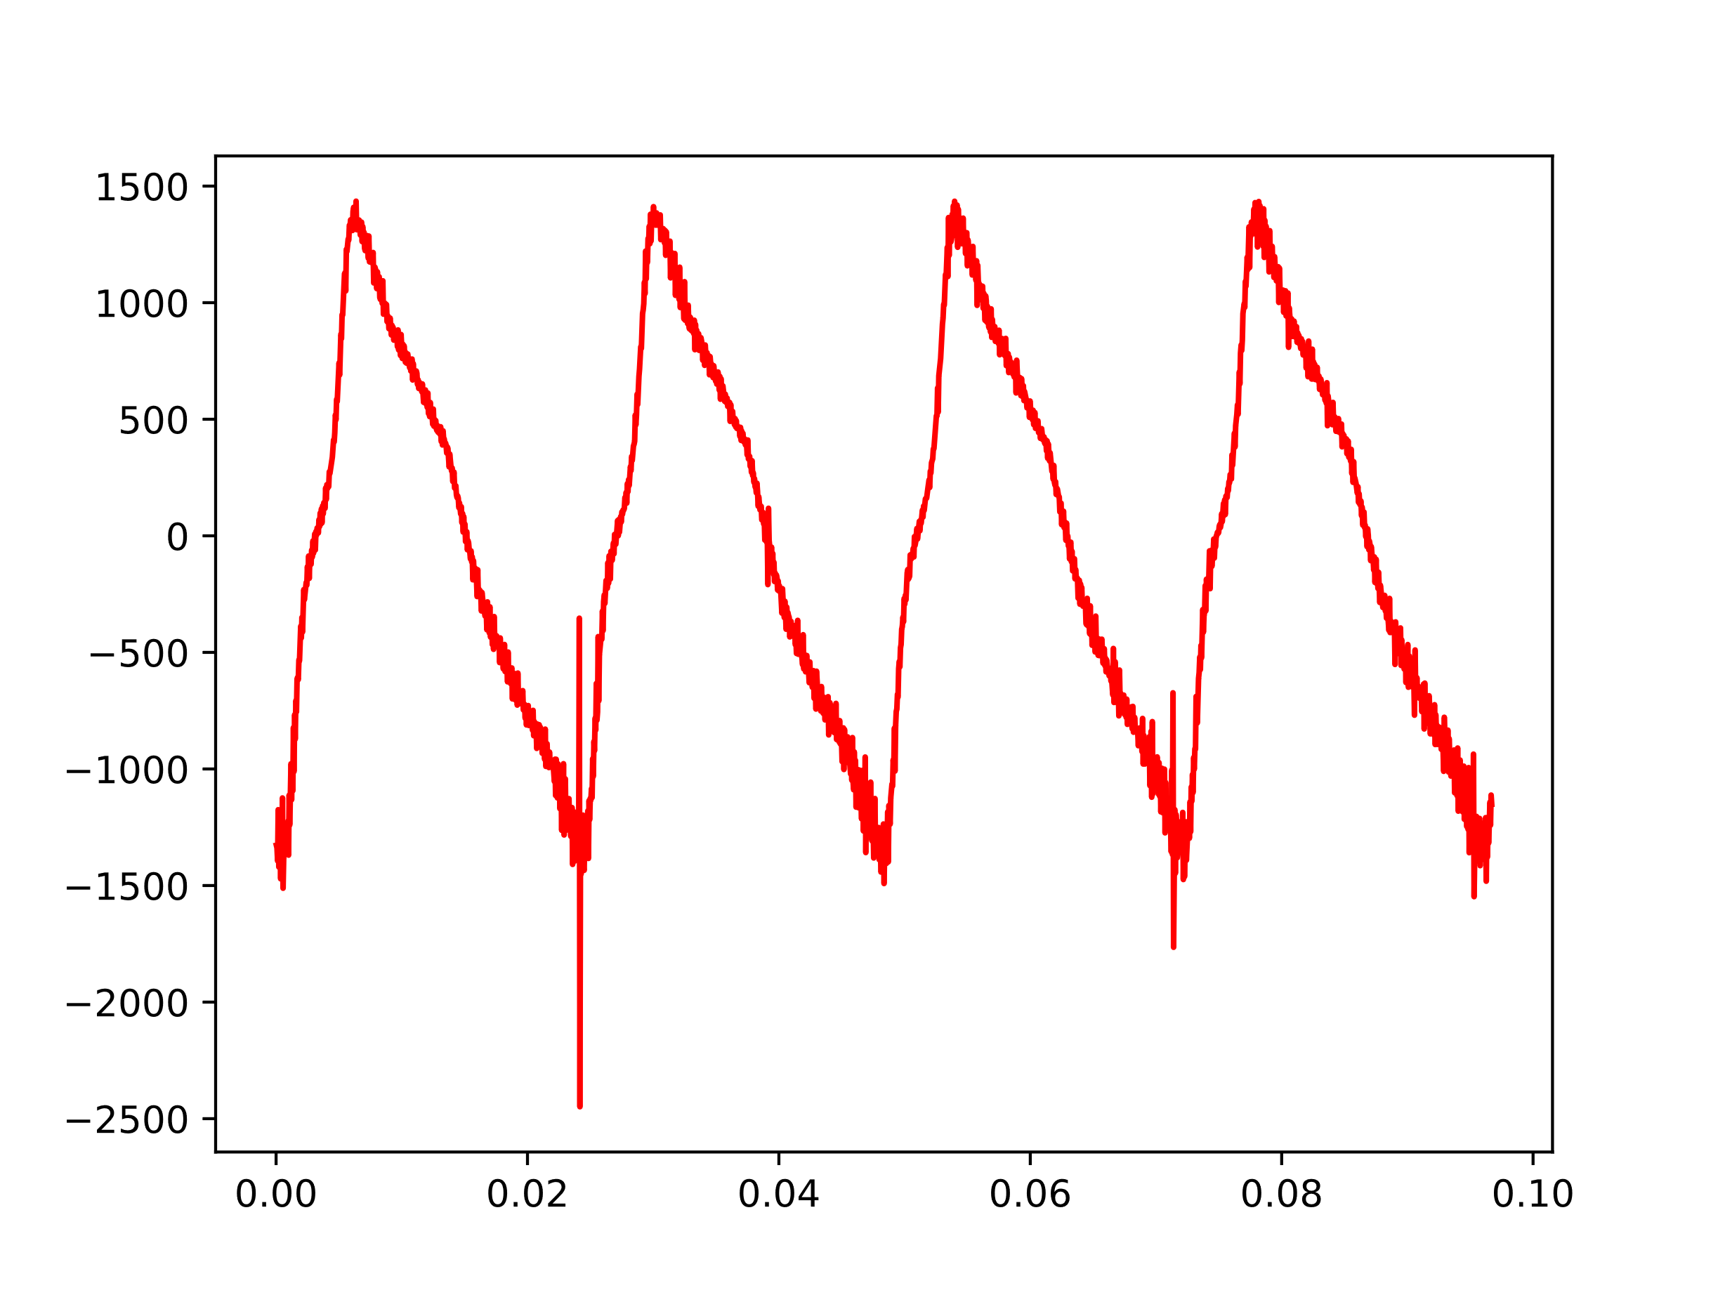
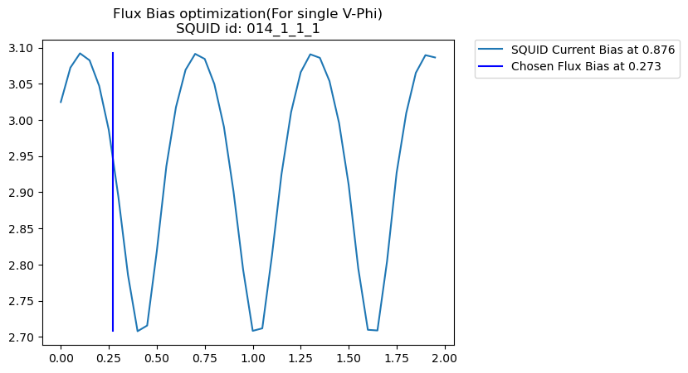
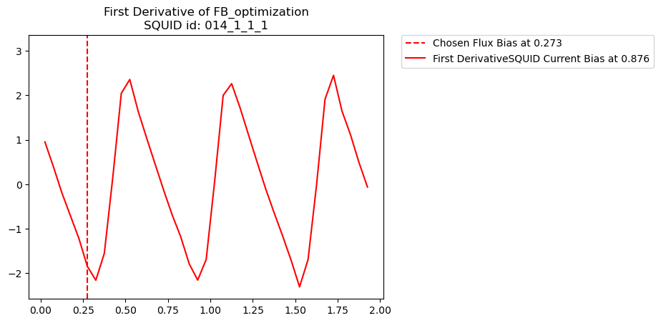
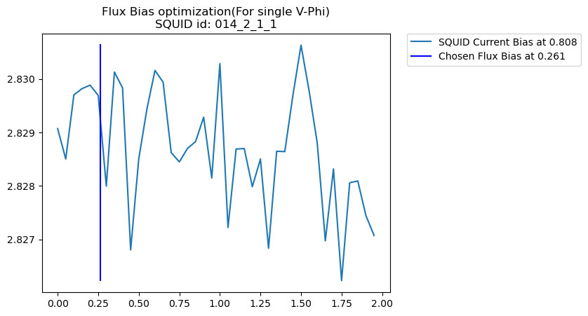
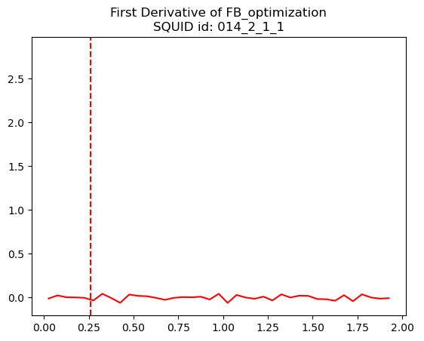
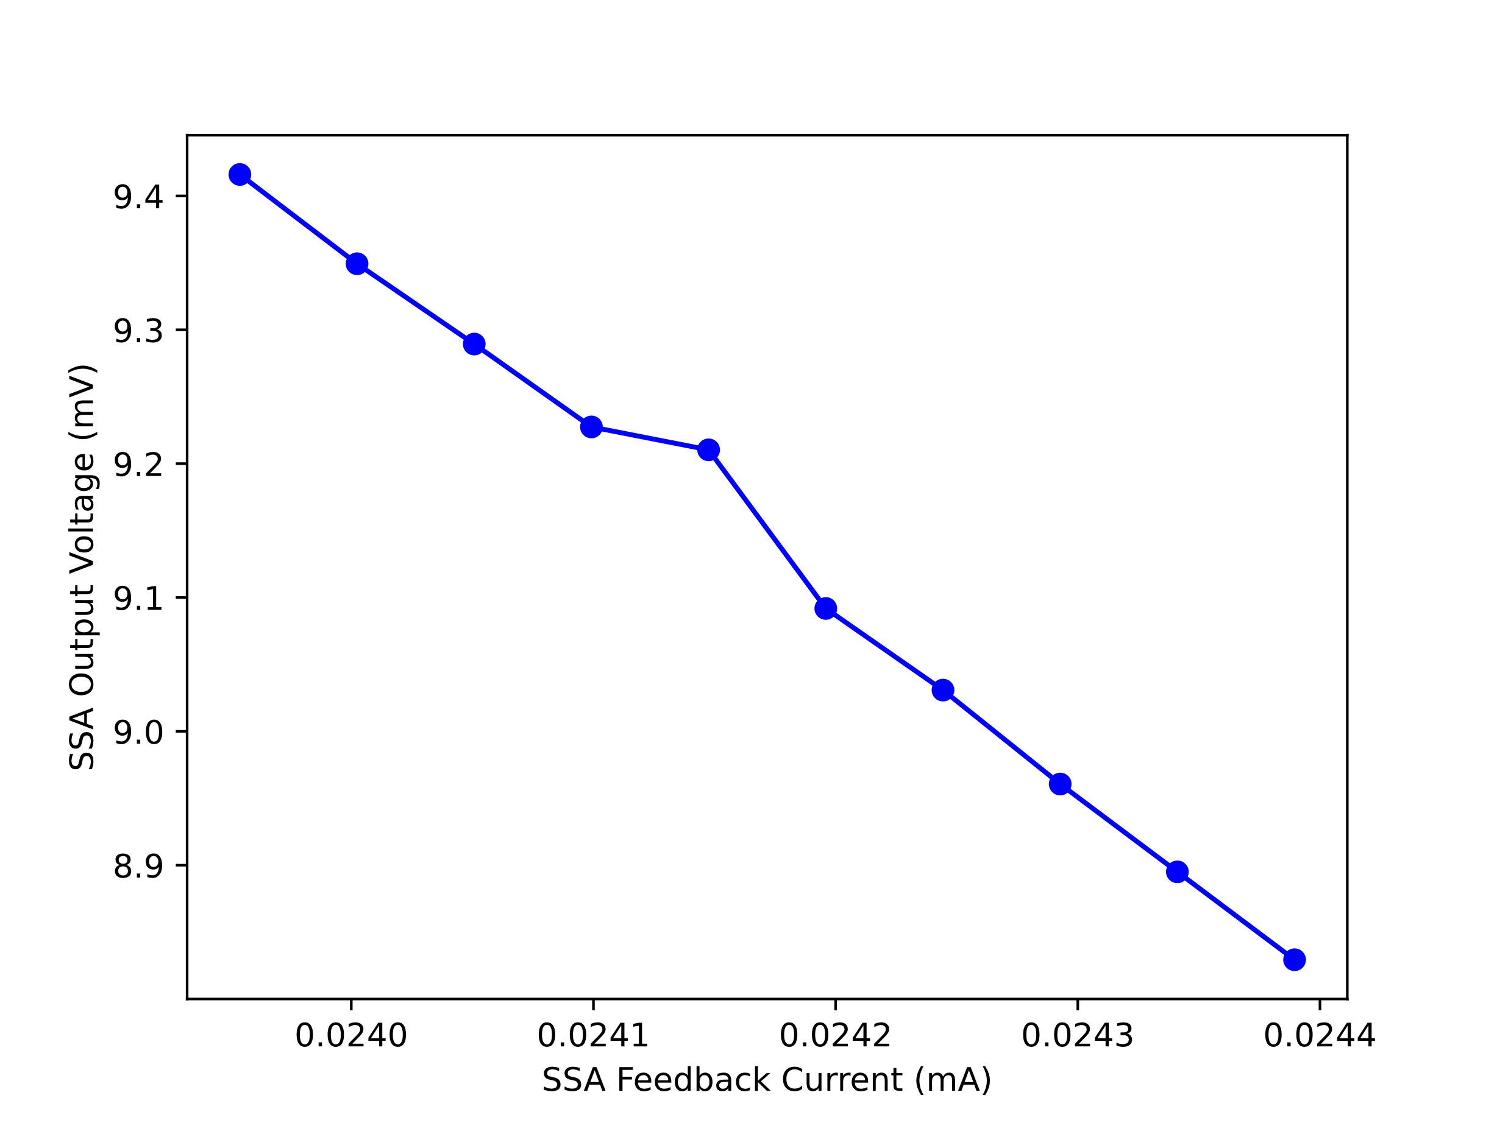
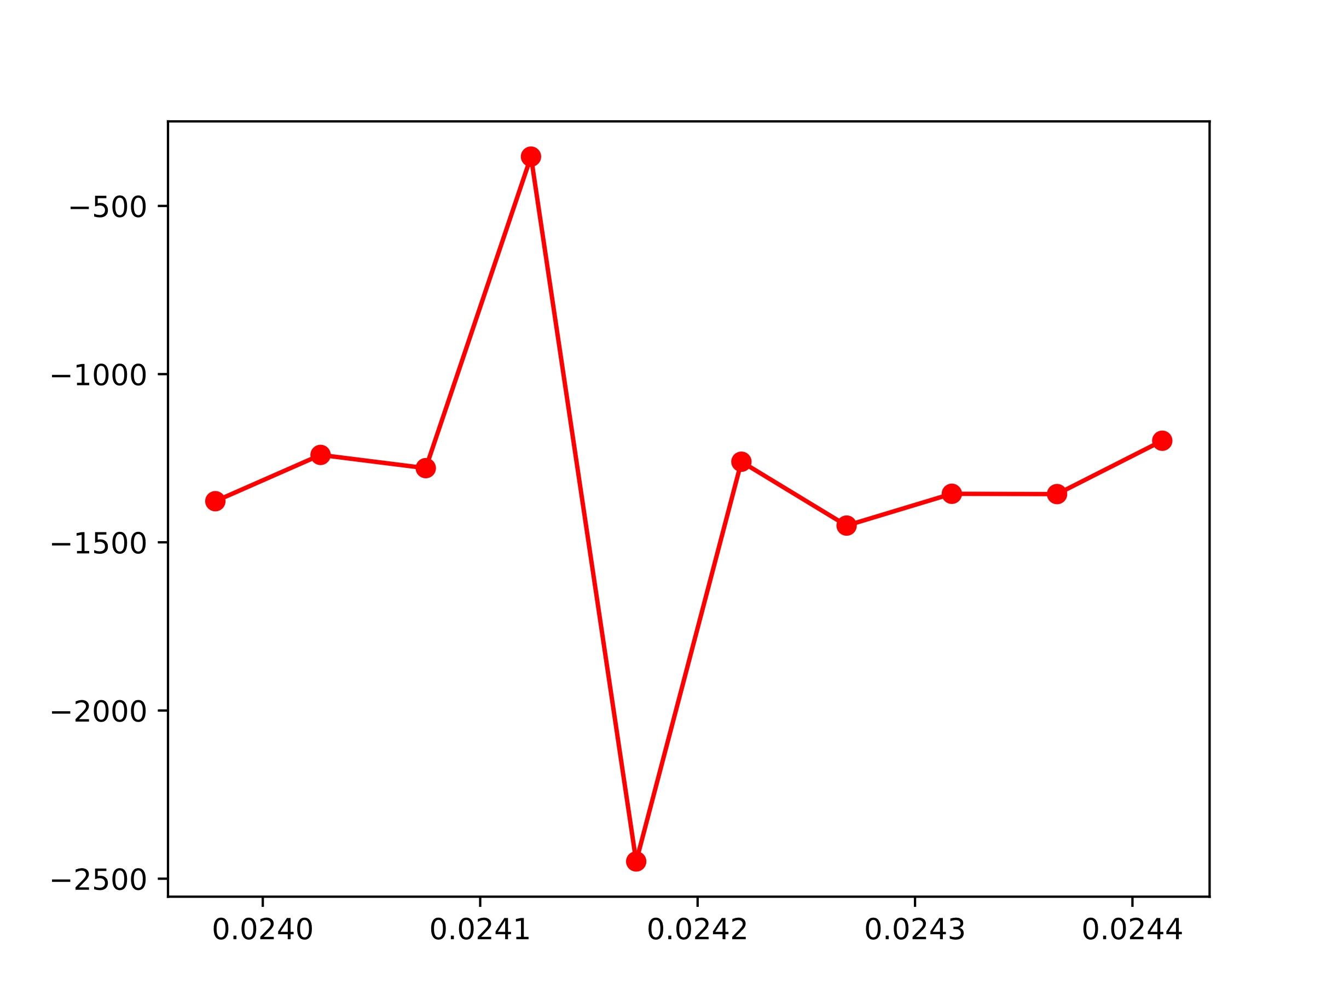
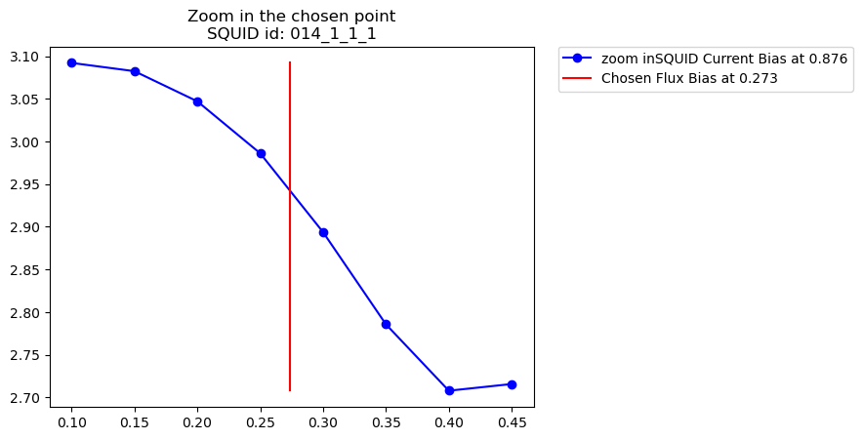
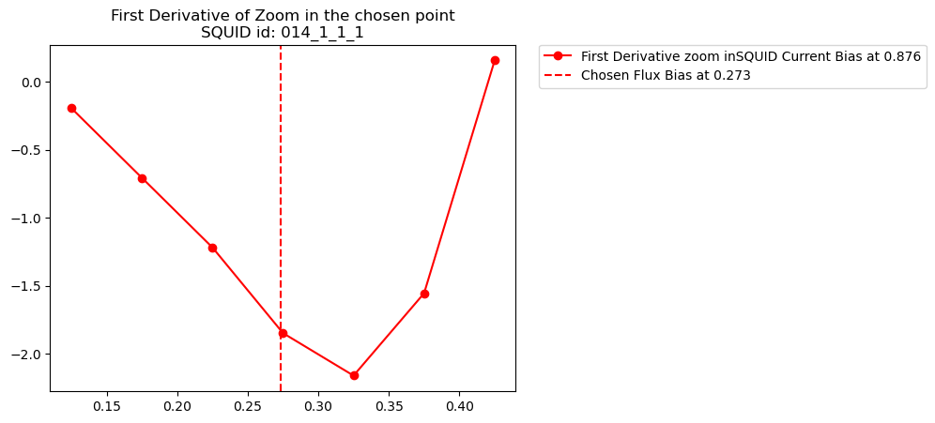
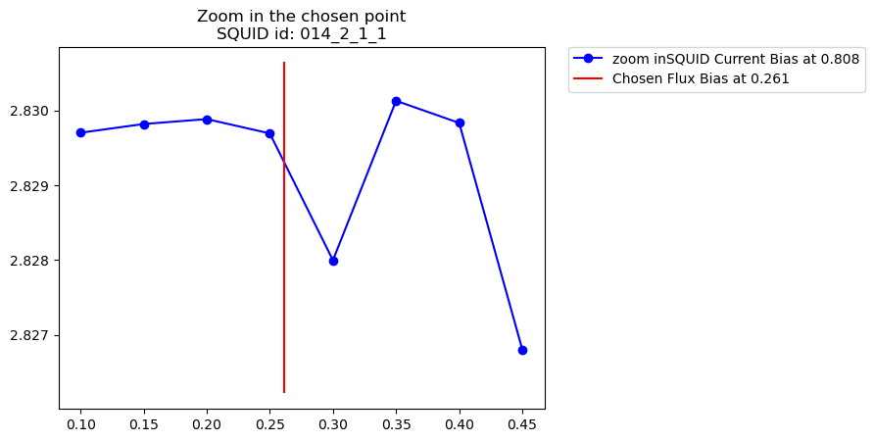
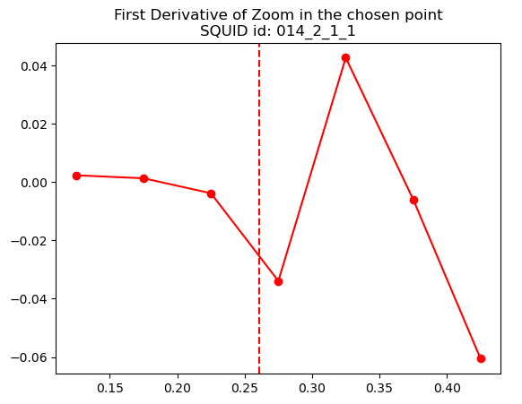
Analysis Wafer and SQUID for better measurement the CMB
Yifu Chen¹, and Dr. Darcy Barron¹
¹Center for High Technology Materials and Department of Physics and Astronomy, University of New Mexico, Albuquerque, NM, USA
Introduction
The Big Bang is a physical theory that describes how the universe expanded from an initial state of high density and temperature [1].
The cosmic microwave background (CMB) is microwave radiation that fills all space in the observable universe [1].
Wafer mapping
The Wafer is one detect plate for telescope.
Goal 1
Goal 2
To avoid the crosstalk in one wafer :
Goal 1: distance between related pad
Goal 2: distance between “neighbor” pixel
SQUID Tuning
what is SQUID
Why important
The purpose for analysis tuning
Mr. SQUID?
conclusion (future work)
References
Acknowledge
Wikipedia
https://lovinthings.com/big-bang-true-facts/
L.A. Howe, Doctor thesis (2019).
K. Prabhu, ApJ (2024).
QU-REACH
()

